Slide 1

Git Insights – GitHub Repo Analyzer
RSOC-2025
<Caffeine & Code>
</
Vedant Wahane
Sankalp Ramteke
Piyush Jharariya
Jay Dhurve
/>
<Team>
Analyse Smarter. Fix Faster.

Slide 2
The Repo Analyzer
Limitations
Developers often need quick insights into GitHub repositories, such as contributor activity, issue trends, and pull request pa erns. Manually checking repo stats is me-consuming, and GitHub's default analytics lack customization.
Problem Statement
Statistics
Innovative Solution
Approx. 50% of software developed late.
42% software developers encounter code conflicts at least once in a week.
Average 57 minutes a day developers waste waiting for builds to complete.
How It Works
Limitations
⚠️Time Consuming Manual Checks
⚠️Lack Of Analytics Customization
⚠️Fragmented Data
⚠️No Predictive Insights

Slide 3
What Sets Our Repo Analyzer Apart?
Debugging
Problem Statement
✅ Repository Activity Metrics
Summaries of commits
Unlike traditional analysers, it adapts to the developer’s Repo patterns.
✅ Codebase Structure Visualization
Provides visual representations.
Helps in comprehending project architecture.
✅ Contributor Analysis
Insights into contributor activities.
Includes commit counts and pull request statistics.
✅ Code Quality Assessment
Evaluate code structure, identify anti-patterns.
Suggest best practices to enhance
Maintainability.
Innovative Solution
How It Works

Slide 4
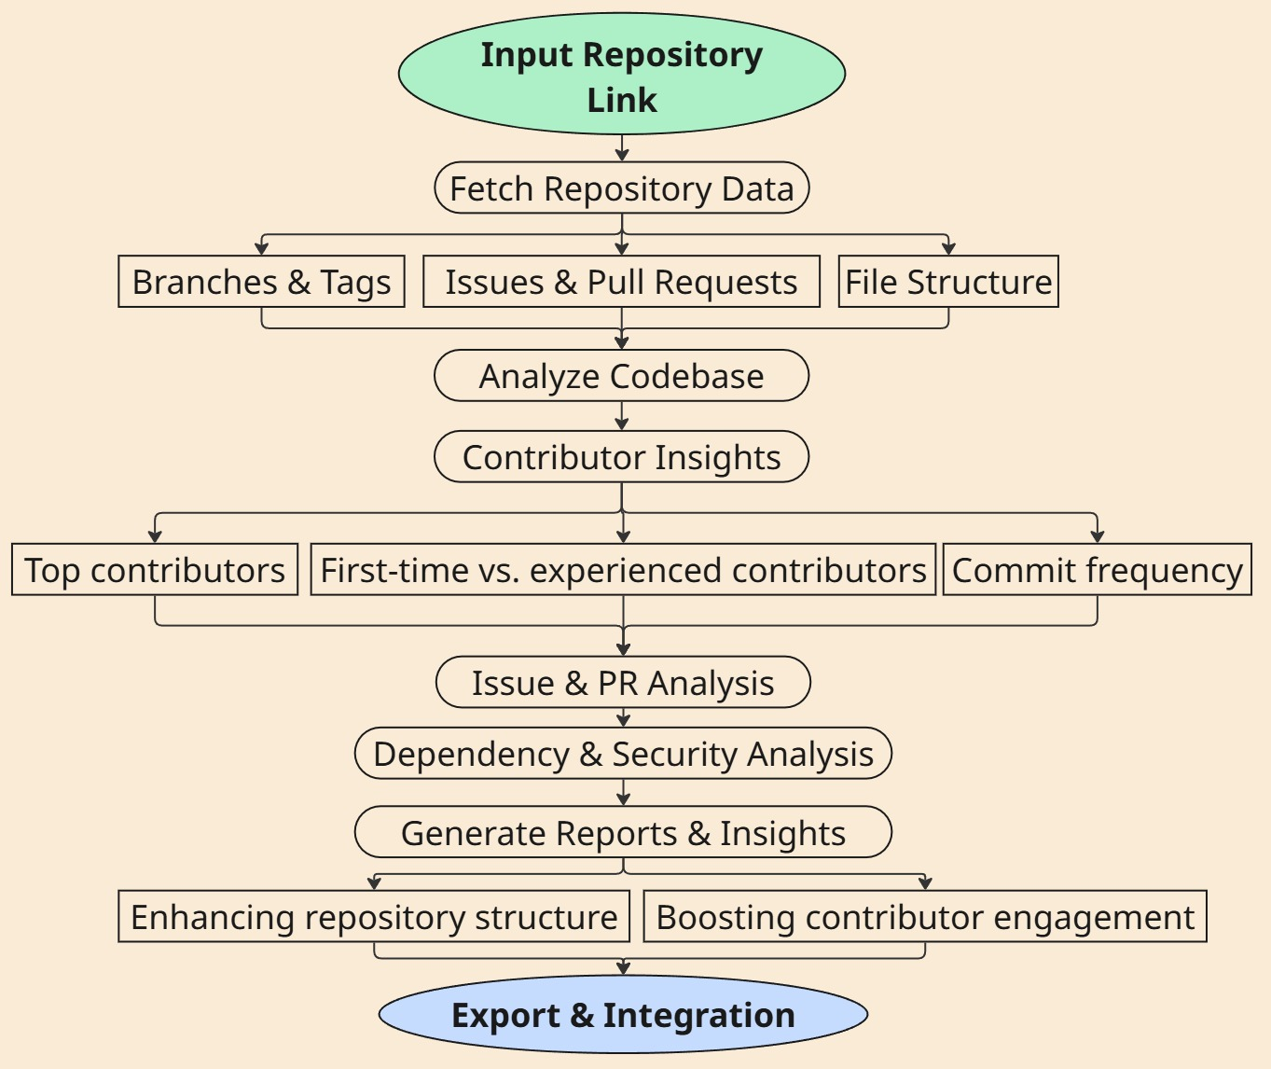
Working Process
Technical Specifications:
Languages: Python 3.9+, JavaScript.
Frameworks: React.js, Node.js, Express.js.
Dependencies: Axios, date-fns, react-dom, recharts.
API: GitHub API.
Deployment: Vercel.
Data: GitHub, BigQuery, Stack Overflow.
Problem Statement
Innovative Solution
How It Works

Slide 5

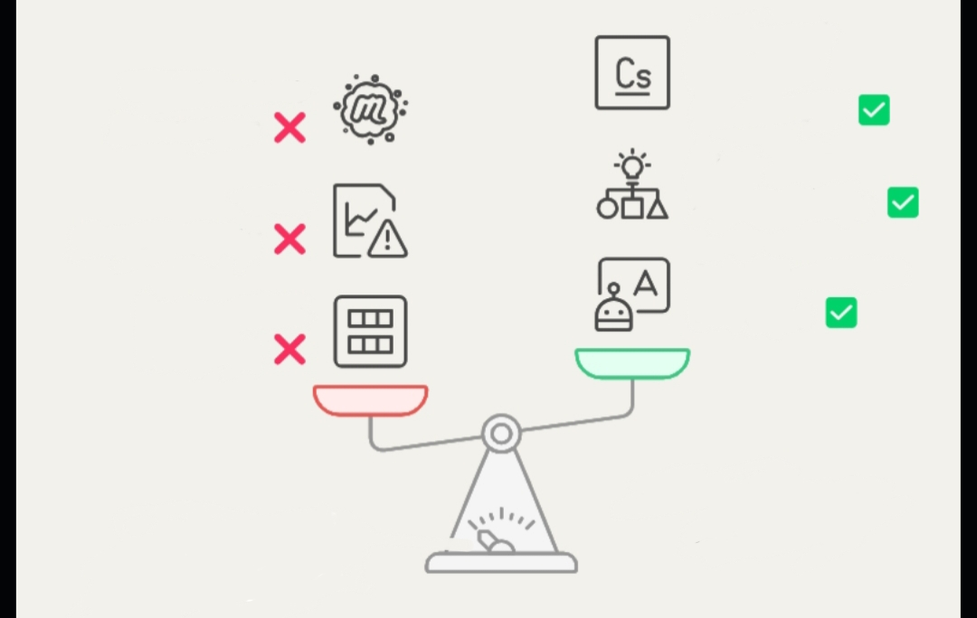
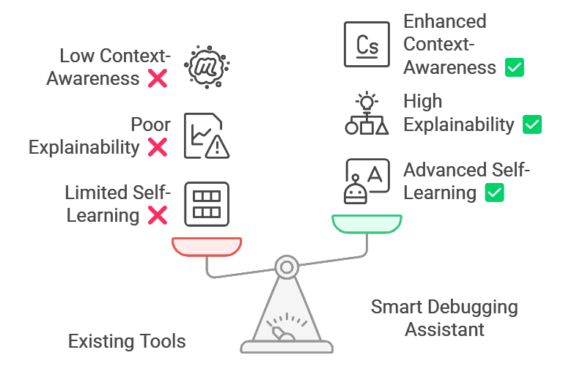
Competitive Edge – Why This Will Win
Code Quality Assessment
Data Driven Analytics
Generic
contributor
Stats
Visualization
Enhanced Visualization
Poor
Visualization
Collaboration
Anonymous access
Zero Trust
Authentication
Authentication
Language Expansion
Unlike Copilot, our assistant explains the fix and improves over time.

Slide 6
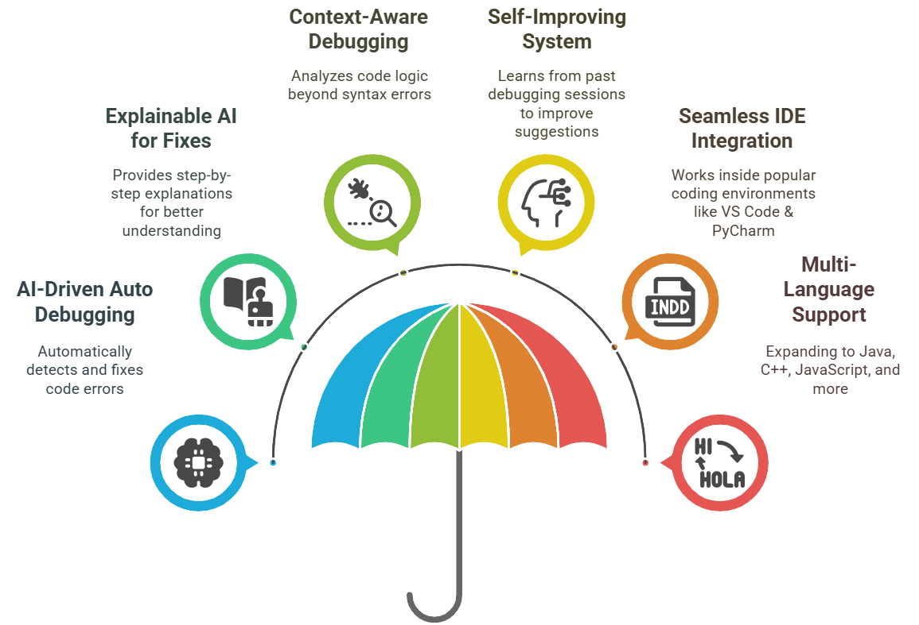

🚀 The Road Ahead: Future Innovations
AR Code Visualization
3D interactive project mapping.
AI Predictive Analytics
Forecast vulnerabilities and performance issues.
Let’s
Build
the
Future
Together!
AI Code Reviews
Smart chatbots for repository insights.
Blockchain Integrity
Tamper-proof commit tracking.
Self-Healing Code
AI-powered automated refactoring.
Adaptive Security
Real-time anomaly detection.

